Slide 1

Healthcare Data Analysis using Excel / ETL Tools/ power bi
Exploratory Data Analysis (EDA)

Slide 2

objective
Analyze hospital dataset to extract meaningful insights
Clean and transform raw data for better accuracy
Generate KPIs and visual dashboards for decision-making
Problem Statements Solved with Charts

Slide 3






Data Preparation
Dataset cleaning
data Organizing
Data Formatting
charts
dashboard
(Raw data taken from Kaggle)
Success
Data Cleaning Steps which I have followed:
Standardized patient names → Proper Case (First letter capital)
Created Age Groups (10-year intervals)
Calculated Hospital Stay Days (Discharge – Admit Date)
Added Index Column for unique identification
Cleaned data used for Pivot Tables & Charts

Slide 4




Tools & Techniques
Which I have use
Microsoft Excel
Power Query
Power BI
Microsoft Power Point
ETL Process → Data Wrangling, Profiling
Excel / Pivot Tables / Formulas for problem solving
Power BI Charts for visualization (Bar, Pie, Line, Stacked etc…..)
Power Point for Presentation

Slide 5

Patient Demographics
Distribution of Patients by Age Group
Highest patient concentration is in the 51–60 age group (8,297 patients).
Other major groups include 61–70 (8,228) and 41–50 (8,209), showing a similar distribution.
Numbers gradually decline in younger (21–30, 11–20) and older (81–90) groups.
Overall, majority of patients are aged 31–70, indicating mid-to-late adulthood as the most affected age range.
Key Predictions & Recommendations
Focus screening & prevention on 31–70 age group (highest risk).
Prioritize 51–60 years for targeted health programs.
Start early detection & awareness in younger groups (11–30) to reduce future cases.
Allocate fewer resources to 80+ group but ensure palliative/supportive care.

Slide 6


gender ratio of patients
Gender-wise Distribution
Prediction & Recommendations
Females: 27,726 (49.91%)
Males: 27,774 (50.09%)
Almost equal distribution between genders
Condition affects both genders equally, so interventions should not be gender-specific.
Design inclusive awareness campaigns targeting both men and women.
Ensure equal access to screening and treatment programs for both genders.
Collect more gender-specific data for deeper insights into risk factors.

Slide 7
BLOOD TYPE DISTRIBUTION OF ADMITTED PATIENTS
Blood Type Distribution
Most common: A- (6,969 patients)
Other groups are fairly close in number (6,877 – 6,956 range)
Recommendations
Maintain balanced blood bank inventory, with slightly higher stock for A-.
Investigate whether A- group has higher susceptibility to specific conditions.
Use findings for emergency preparedness and resource allocation.

Slide 8

Hospital & Doctor Performance
Top 10 Doctor by Number of Patients Treated
Michael Smith treated the most patients (27 cases).
Robert Smith and John Smith follow with 22 cases each.
Other top doctors treated 17–20 patients each, showing relatively balanced distribution after the top three.
Key Predictions & Recommendations
Michael Smith may continue to see higher patient volume, indicating either specialized expertise or high patient trust/referral rate.
Consider even distribution of patients among doctors to manage workload and prevent burnout
Analyze best practices of top doctors (Michael, Robert, John Smith) and apply to improve overall care quality.

Slide 9

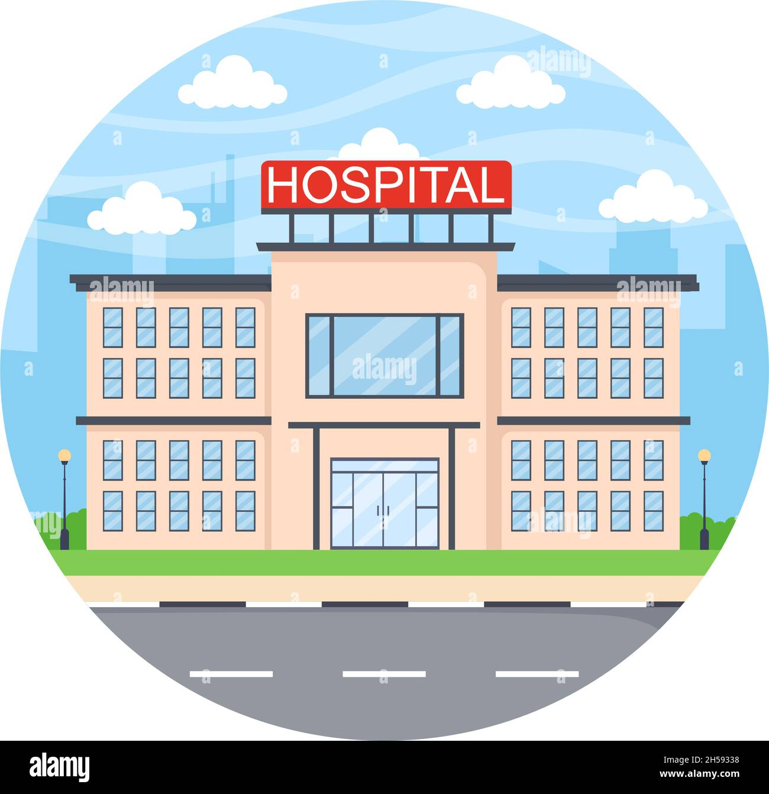
Hospital with Highest Patient Inflow
Summary
Prediction
Recommendations
Top hospital recorded 44 patients, the highest inflow.
Other hospitals range between 32–39 patients, showing moderate variation in patient load.
The top hospital is likely to remain the primary patient hub, potentially facing higher demand for resources.
Patient inflow may continue to rise if no redistribution measures are taken.
Allocate additional resources (staff, equipment, beds) to the top hospital to handle higher demand.
Analyze reasons for higher inflow (location, reputation, services) and replicate success strategies in other hospitals.
Balance patient referrals across hospitals to prevent overburdening a single facility.

Slide 10

Most Frequently Occupied Room
Summary:
Room 393 is the most frequently occupied (181 times).
Other high-occupancy rooms: 491 (177), 420 (175), 104 (175).
Occupancy gradually declines across other rooms (168–171 range).
Recommendations:
Inspect and maintain Room 393 regularly to avoid service disruption.
Distribute patient allocation more evenly to optimize room usage.
Analyze reasons for preference (location, size, proximity to wards) and apply improvements to lower-occupancy rooms.
Prediction:
Room 393 may continue to have highest demand, indicating either its preferred location or better facilities.
Similar rooms with high usage may experience faster wear and tear over time.

Slide 11
Medical Condition Analysis
Condition Burden & Resource Impact
Key Insights
Most Common Condition:Arthritis (9,308 patients) is the most prevalent condition, followed closely by Diabetes (9,304) and Hypertension (9,245).Longest Hospital Stay:Arthritis also accounts for the highest admit days (144,436), indicating significant resource utilization.Asthma and Diabetes follow with high hospitalization days
Prediction
Arthritis will remain the top driver of admissions and hospital stay, increasing demand for long-term care.
Chronic conditions (Diabetes, Hypertension, Obesity) will continue to rise, straining hospital capacity.
Recommendations
Expand arthritis management programs (physiotherapy, pain management, home-care options).
Promote preventive lifestyle campaigns to control Diabetes, Hypertension, and Obesity.
Implement care pathway optimization to reduce unnecessary hospital stays.
Allocate more rehabilitation resources to speed up recovery and free up hospital beds.

Slide 12



Medical Condition with Highest Billing Amount
Key Insights:
Diabetes has the highest total billing amount (238,539,725.5).
Closely followed by Obesity (238,214,920.7) and Arthritis (237,329,120.2)
.All chronic conditions show very high financial impact, with Cancer being slightly lower.
Prediction:
Diabetes-related costs are likely to keep rising due to lifetime treatment needs (medication, complications).
Obesity and Arthritis will also remain major contributors to healthcare expenses.
Recommendations:
Implement preventive programs to reduce long-term diabetes and obesity costs.
Negotiate cost-effective treatment protocols for chronic conditions.
Encourage patient education to improve self-management and reduce hospital-based expenses..

Slide 13
Age-wise Distribution of Medical Conditions

Slide 14

Financial Analysis
Insurance Provider Distribution & Billing Impact
Summary:
Cigna covers the highest number of patients (11,249) and has the largest billing amount (287M).Medicare and UnitedHealthcare follow closely, with billing amounts of 285M and 282M respectively.
Patient distribution across providers is relatively balanced, with each covering ~20% of total patients.
Prediction:
Cigna is likely to remain the dominant provider, contributing most to hospital revenue.
Balanced distribution suggests no major dependency on a single insurer, but Cigna’s lead may grow.

Slide 15
Financial Analysis
Highest Billing Amount of Medical Condition
Summary:
Diabetes accounts for the highest billing amount (238.5M).
Obesity (238.2M) and Arthritis (237.3M) follow very closely.
Cancer (232.1M) has the lowest total billing among the listed conditions.
Prediction:
Diabetes-related healthcare costs will continue to rise due to chronic nature and long-term treatment.
Obesity and Arthritis will remain major cost drivers, potentially increasing as lifestyle factors worsen.

Slide 16

Key Findings:
Age Distribution: Majority of patients are 31–70 years, with a peak in 51–60 (8,297 patients).
Gender: Almost equal distribution (Males: 50.09%, Females: 49.91%).
Blood Type: A- is slightly more common but all types are fairly balanced.
Medical Conditions: Arthritis is most common (9,308 patients) and also causes longest hospital stays (144k days).
Billing: Diabetes generates the highest billing amount (238M), followed by Obesity and Arthritis.
Doctors: Michael Smith treated the most patients (27 cases).Hospital Inflow: Top hospital recorded 44 patients, highest among all.
Room Occupancy: Room 393 is most frequently occupied (181 times).
Insurance: Cigna covers the highest patients and billing share (287M).

Slide 17

Predictions
Chronic conditions (Arthritis, Diabetes, Hypertension) will continue to dominate patient load and resource consumption.
Mid-age adults (31–70) will remain the largest affected group.
High-demand hospitals and rooms will continue to face pressure if not managed strategically.
Cigna will likely remain the top insurance provider, further increasing its share.

Slide 18

Thank you
BHAGWATI PRAJAPAT
DATA ANALYST
bhagawatipararaiya@gmail.com
9587392770

